Slide 1
Communicating with Data– Prototyping
Dr. Ab Mosca (they/them)
Slides based off slides courtesy of Jordan Crouser (https://jcrouser.github.io/)

Slide 2
Coming Up

Slide 3
Coming Up

Slide 4
Coming Up
Final Project!
Instructions will be released next week on Thursday
Yes, you do need to work with a group.
If you’d like help finding a group, send me a message on Slack before next Tuesday
Start thinking about a topic area you’re interested in

Slide 5
Plan for Today
User-centered design
What it is
Why do it
Ways to do it
Paper prototypes

Slide 6
Hypothetical Example
Admissions asks you, a visualization expert, to make a visualization summarizing Smith College.
How do you start?
Notes:
https://scenarioviewer.nrel.gov/

Slide 7
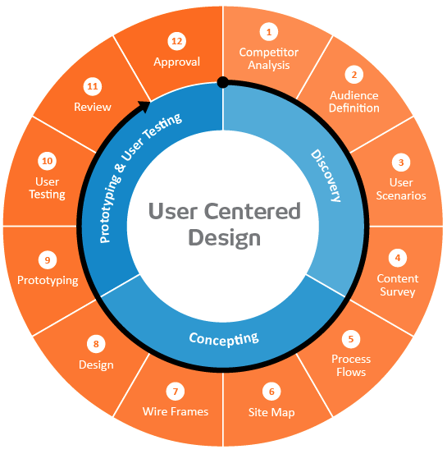

User-centered design framework
1) Discovery
Learning about your users
Modeling your users
Analyzing your users’ tasks
Eliciting and defining clear product requirements
2) Concepting Phase
Developing conceptual models
Solving design problems through ideation
Detailed design activities
3) Prototyping + User Testing
Delivery of a high-quality product that meets users’ needs and is easy to learn and use
Users
http://www.uxmatters.com/mt/archives/2010/07/design-is-a-process-not-a-methodology.php
Notes:
All Phases
Each phase feeds into the next
Iteration is key!
Users involved at all phases of the process

Slide 8
Discovery: Competitor Analysis
Why?
If you look at what already exists, you might be able to identify potential issues in advance
Also helps establish your unique contribution
How?
Literature or product review
Analysis
What are the existing tools?
What is their purpose?
What audience are they aiming for?
What kinds of strategies are they using?
What functionality do they contain?
What are their strengths and shortcomings?
Identify opportunities and design constraints

Slide 9
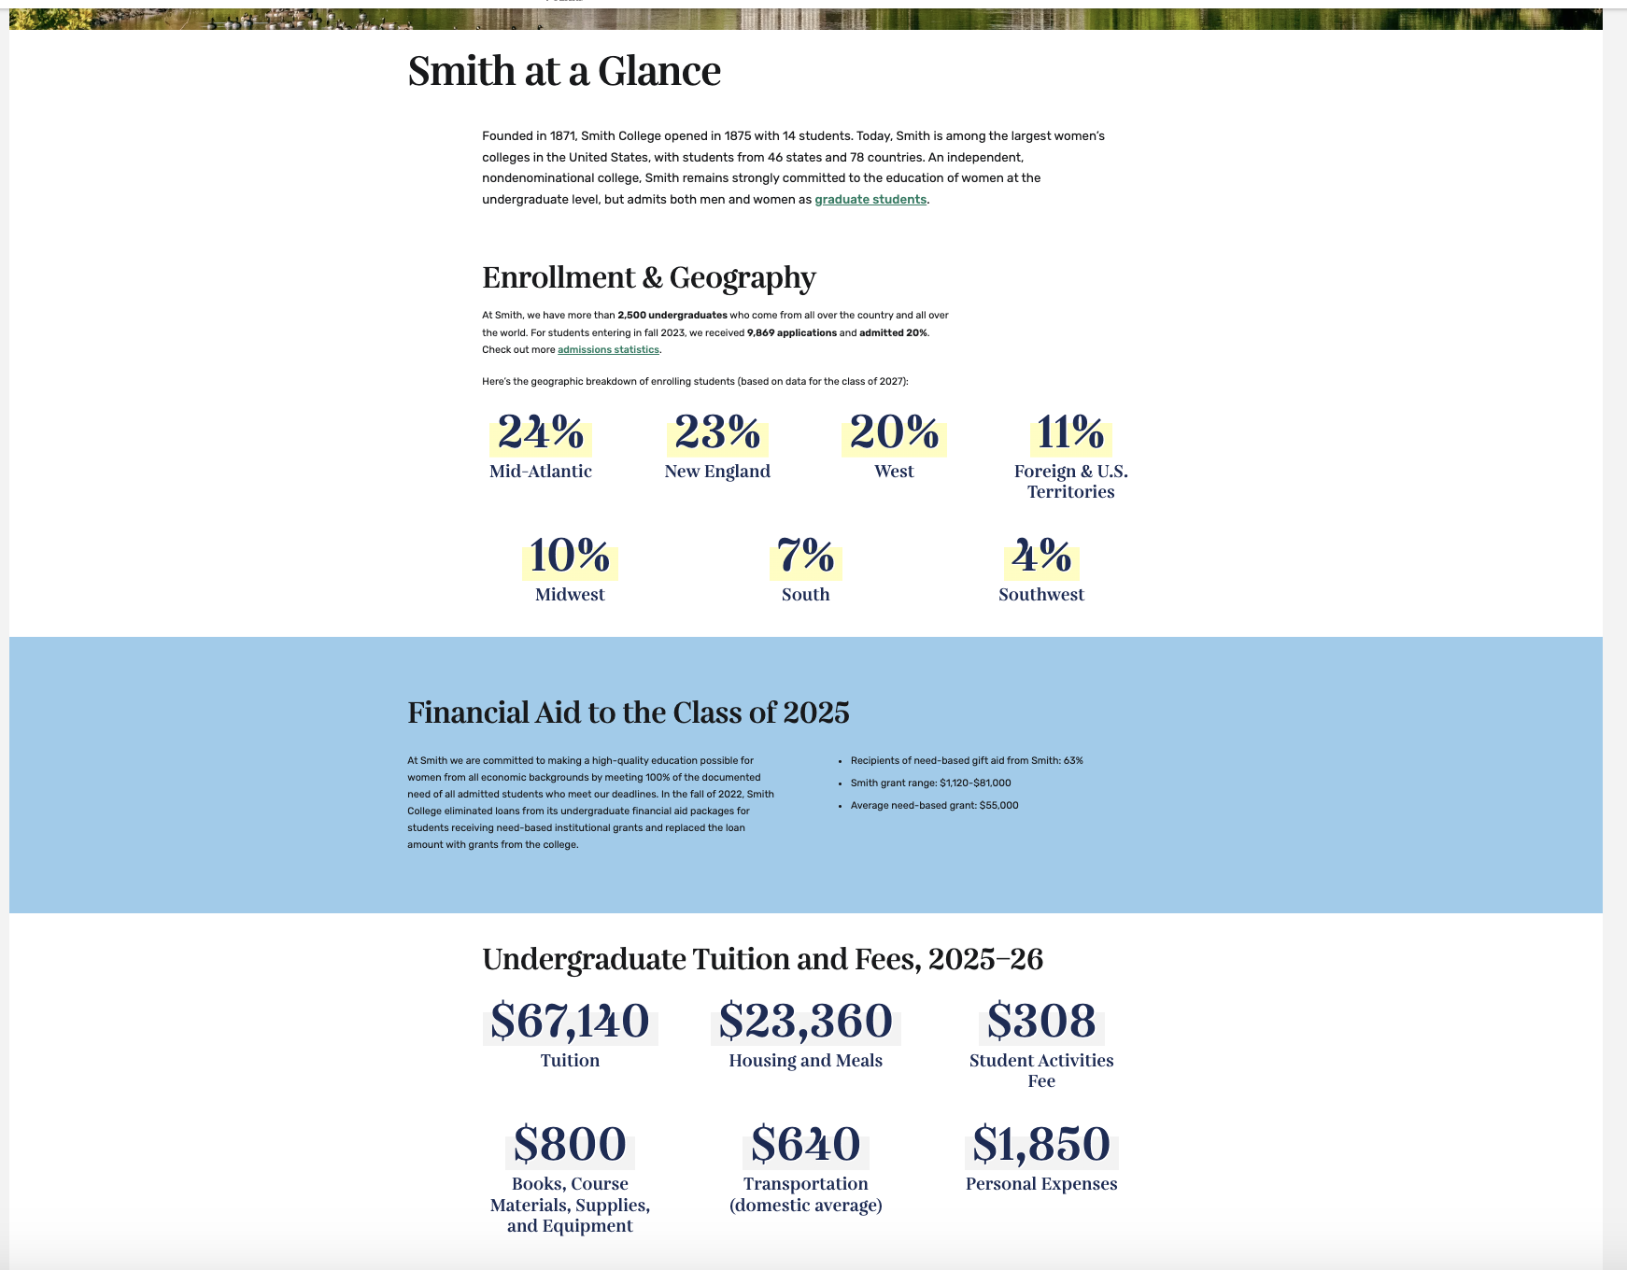
Discovery: Competitor Analysis
https://www.smith.edu/discover-smith/smith-glance
Notes:
Should we use icons for extra info?

Slide 10
Discovery: Audience Definition
Learning about their problem
Semi-structured interview
Analyzing their tasks
Hierarchical task analysis
Modeling users
Personas

Slide 11
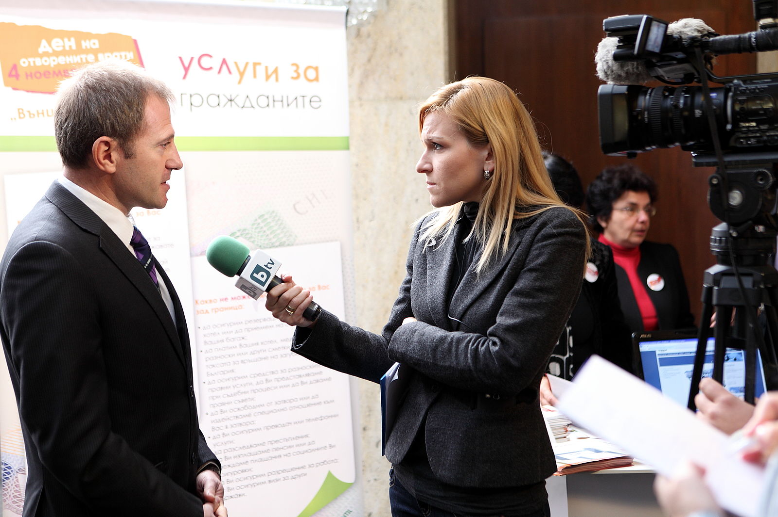
Semi-structured interviews
Why?
gather qualitative data about users to understand the problem
can help identify key differences between designer and target user
How?
ask open-ended questions
bring along a “cheat sheet” to
ensure that you gather all the
information you need
Some tips:
establish trust at the beginning
participant engagement will vary
be flexible, but make sure you get what you came for
consider recording or note-taking to help with recall
Wood, L. E. (1997). Semi-structured interviewing for user-centered design. interactions, 4(2), 48-61.

Slide 12
Hierarchical task analysis
Why?
Understand user workflow
Identify pain points and areas for optimization
How?
Decompose tasks into 4-8 sequential steps
Identify patterns, sequences and skips in the tasks
An example:
Hackos, J. & Redish, J. (1998). User and Task Analysis for Interface Design. Chichester: Wiley.

Slide 13
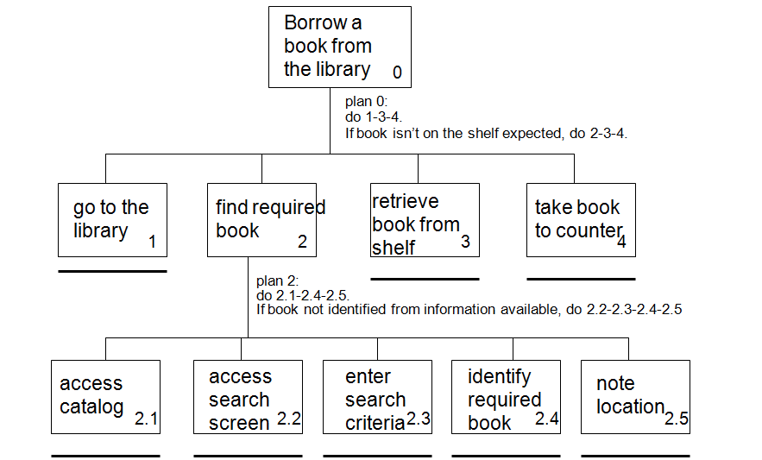
Task analysis example
http://i1206241.blogspot.com/2013/01/task-descriptions-hierarchical-task.html

Slide 14
Personas
Why?
mechanism for reasoning about user needs
model behavioral characteristics of target users
doesn’t require access to ACTUAL users
How?
fictionalization
narrative, goals, needs, “pain points”
attributes specific to the problem space
data-driven method* using info from interviews
mapping persona to software features

Slide 15
Personas
Example for a Smith College dining app
Ellis is a first year Smithie who lives in Wilson. They do cross country and have 6am practice before their 9:25am art history class in the art museum on MWF. On TR, they have engineering 101 in Ford Hall until 12:05, and their work study job at the campus school that starts at 12:45pm sharp. Ellis is a “live to eat” kind of person, and likes to optimize the ”yum” factor in their meals. In addition, they are vegan. They are comfortable using apps on their phone like GoogleMaps, but are struggling to find the time to survey dining hall menus and get to the appropriate dining hall for the meal they want between their various other activities.
Pain Point: Limited time
Goal/Need: Eating what they like
Pain Point: Limited time
Pain Point: Distilling current menu list
Goal/Need: Minimize walk distance
Technical skills: Comfortable with basic apps
Pain Point: Walking far & fast

Slide 16
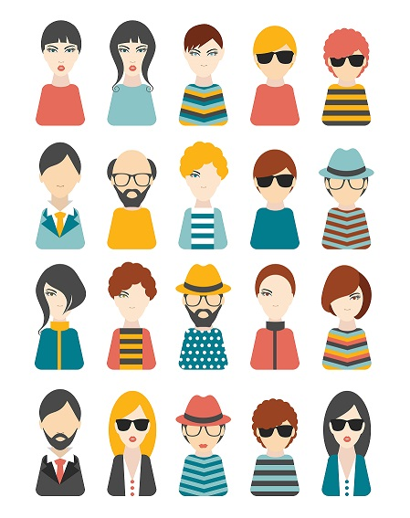
Activity: personas
Goal: come up with a persona that characterizes a user of the visualization admissions asked you to create.

Slide 17
Now that we’ve got some end users in mind,
what would the system look like?

Slide 18
User-centered design framework
1) Discovery
Learning about your users
Modeling your users
Analyzing your users’ tasks
Eliciting and defining clear product requirements
2) Concepting Phase
Developing conceptual models
Solving design problems through ideation
Detailed design activities
3) Prototyping + User Testing
Delivery of a high-quality product that meets users’ needs and is easy to learn and use
Users
http://www.uxmatters.com/mt/archives/2010/07/design-is-a-process-not-a-methodology.php
Notes:
All Phases
Each phase feeds into the next
Iteration is key!
Users involved at all phases of the process

Slide 19
Conceptual Models: Why?
What concepts do your users need to be aware of to use your visualization?
Consider:
What data will they interact with?
How will they interact with it?

Slide 20
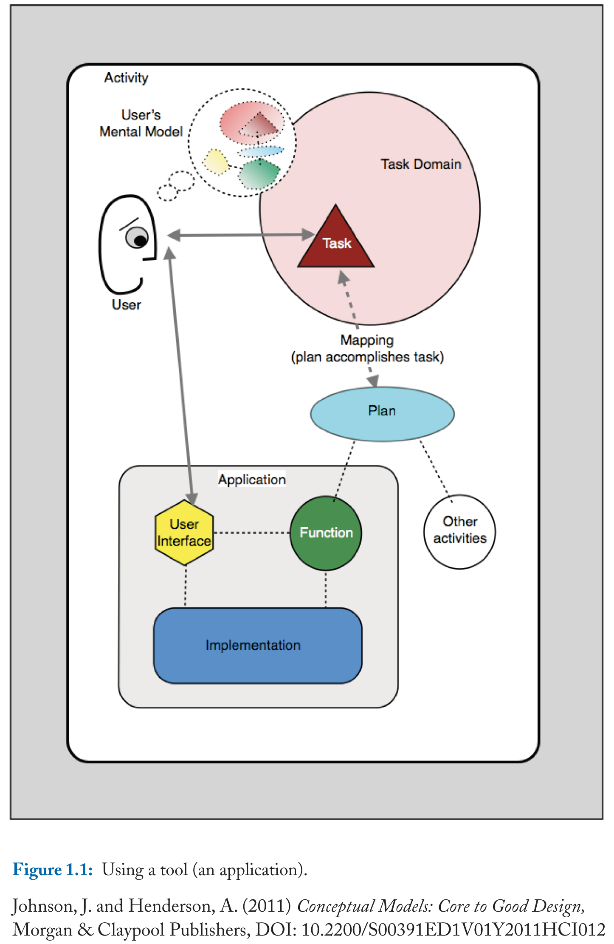
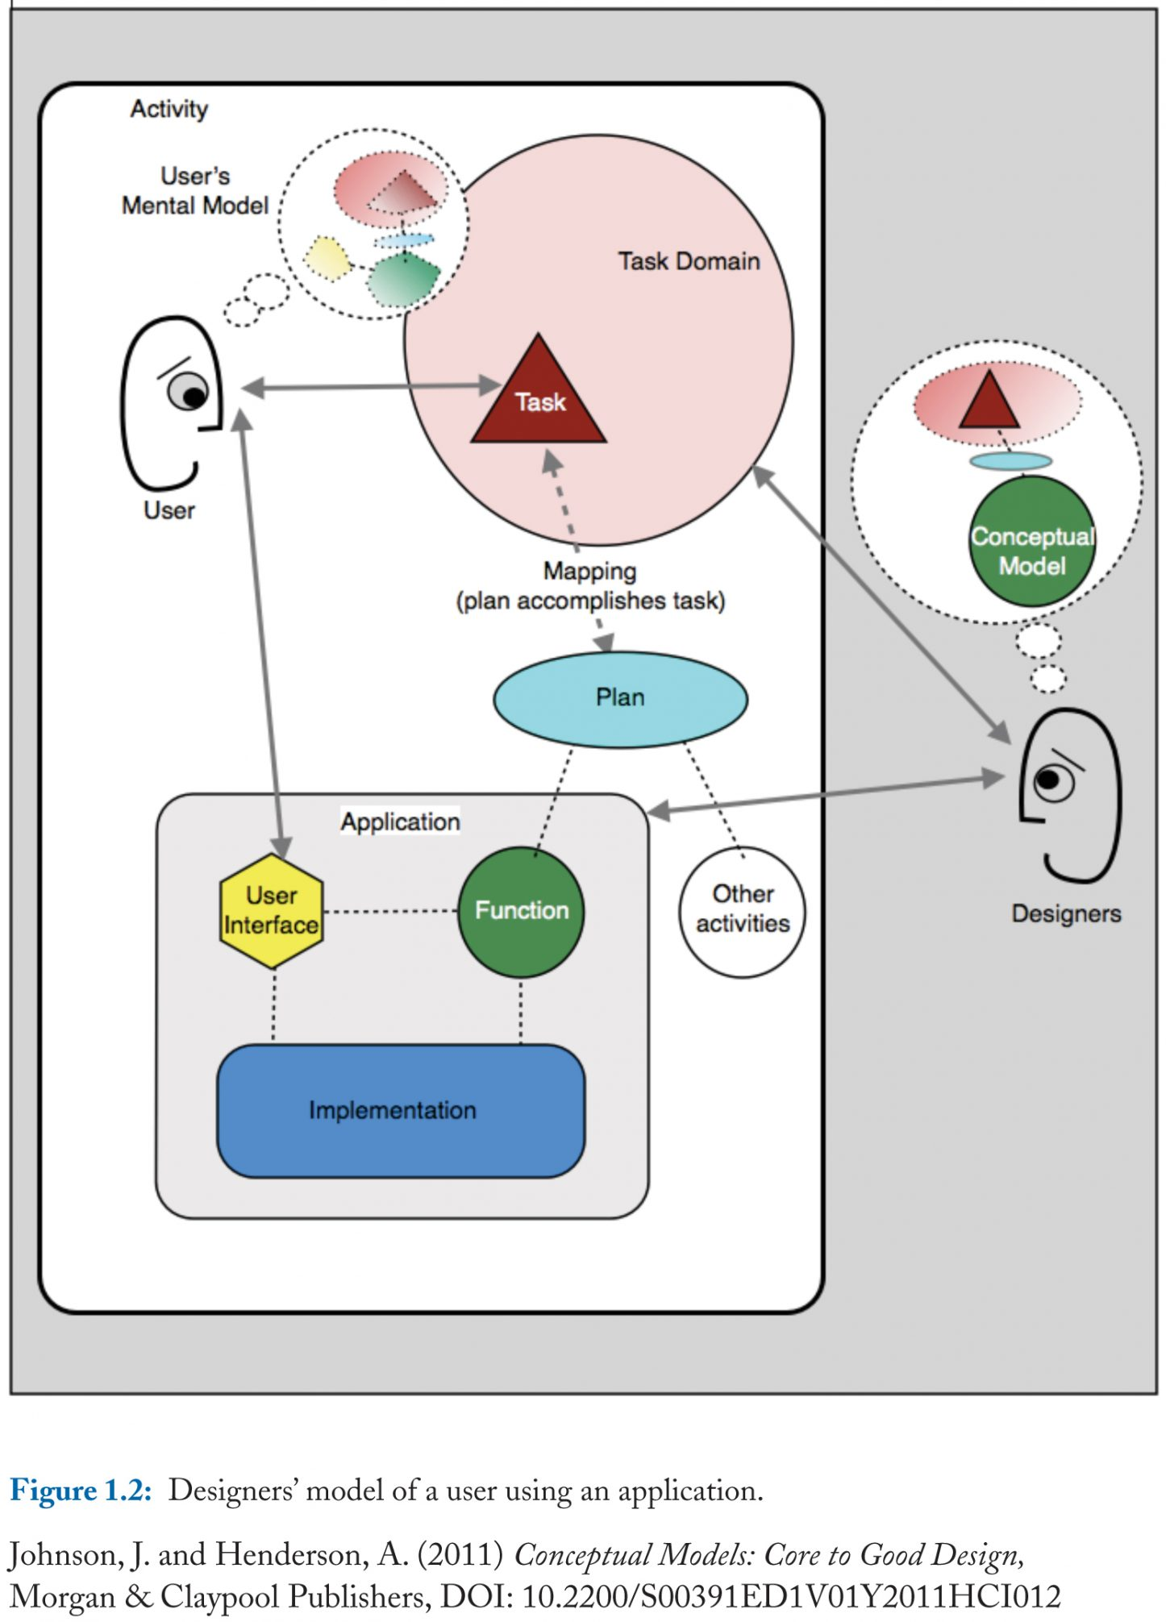
Conceptual Models: Why?

Slide 21
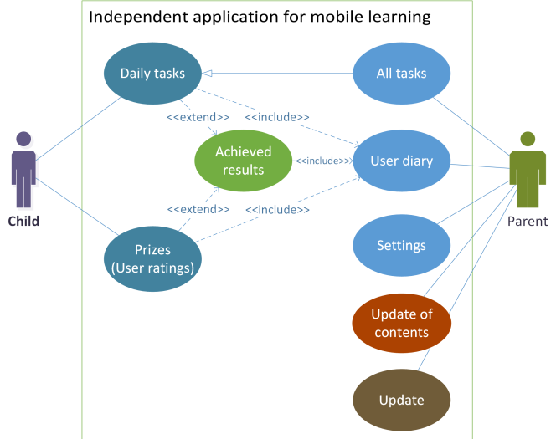
Conceptual Models: How?
Focus on key components and content areas
Describe all essential tasks for your visualization

Slide 22
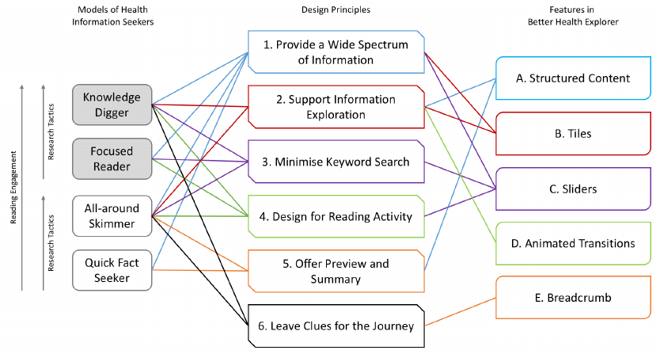
Conceptual Models: How?
Focus on key components and content areas
Describe all essential tasks for your visualization

Slide 23
Activity: Conceptual Models:
Draw a conceptual model for the visualization admissions asked you to make

Slide 24
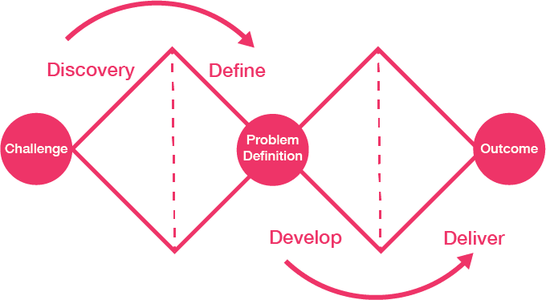
Ideation and Detailed Design

Slide 25
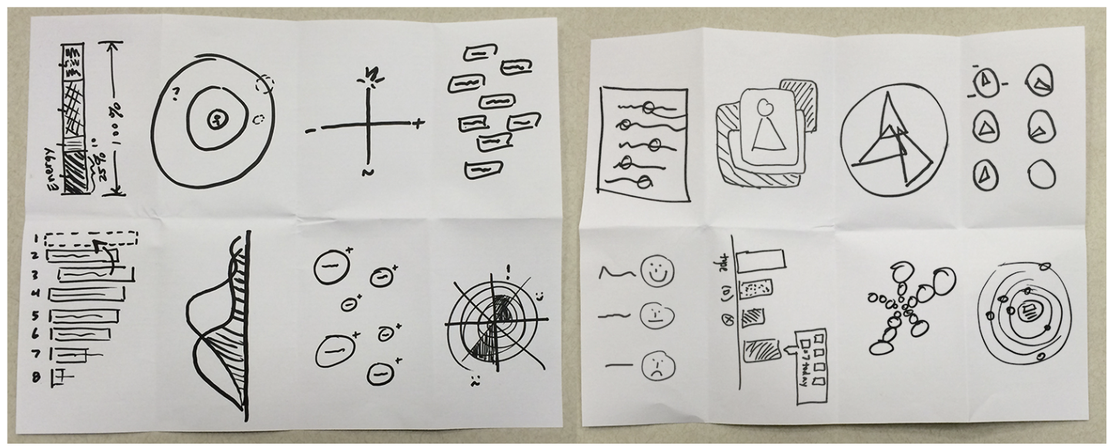
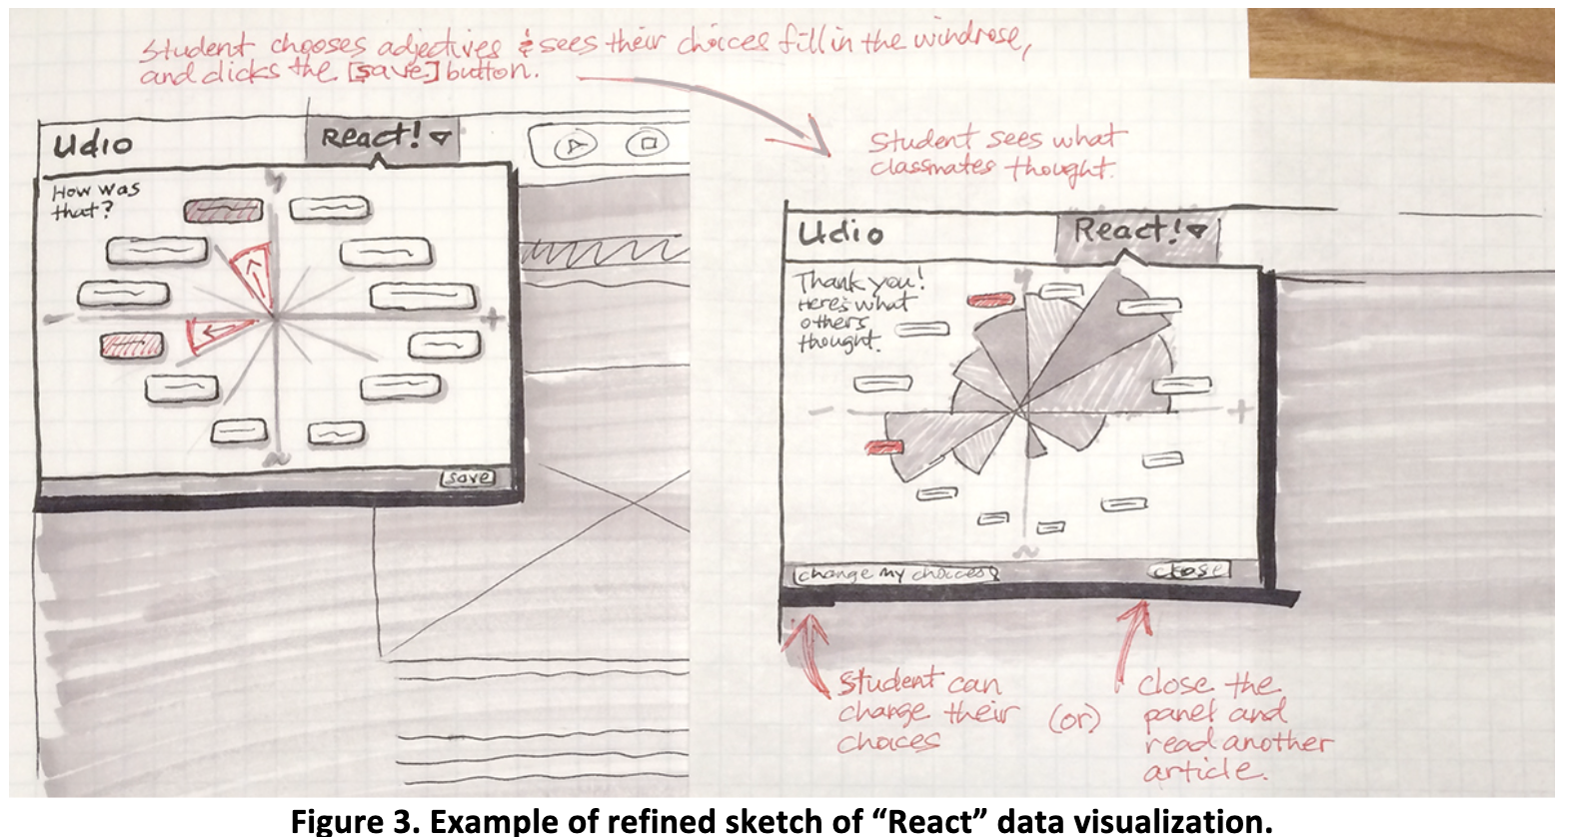
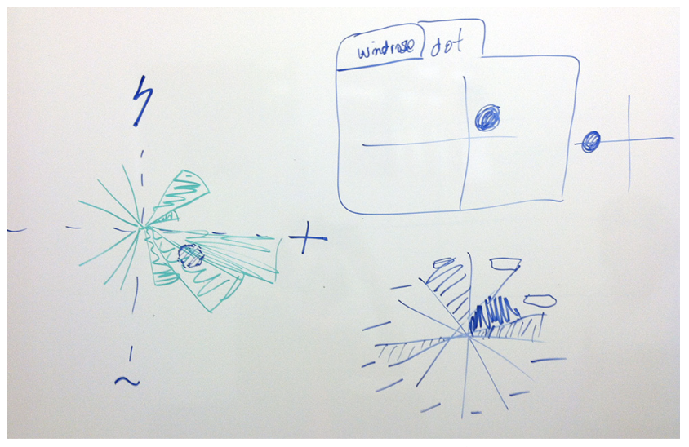
Sketching
What will it look like?
(2016).Prototyping visual learning analytics guided by an educational theory informed goal. Journal of Learning Analytics, 3(3), 115–142.http://dx.doi.org/10.18608/jla.2016.33.7
Notes:
To address these challenges, the Center on Emergent Technology, Disability, and Middle School Reading (CET; cet.cast.org) is researching and developing a technology-rich learning environment that will make it possible for schools to provide allstudents with universally designed for learning (UDL) literacy experiences as they read independently across the curriculum
Udio is a dynamic web of authentic, current, and widely distributed UDL reading environments connected by a central Hub

Slide 26
Sketching
Roughly sketch the visualization you would make for admissions
Pair up with 2 other teams and compare rough sketches
Based on feedback / input draw a more polished sketch

Slide 27
User-centered design framework
1) Discovery
Learning about your users
Modeling your users
Analyzing your users’ tasks
Eliciting and defining clear product requirements
2) Concepting Phase
Developing conceptual models
Solving design problems through ideation
Detailed design activities
3) Prototyping + User Testing
Delivery of a high-quality product that meets users’ needs and is easy to learn and use
Users
http://www.uxmatters.com/mt/archives/2010/07/design-is-a-process-not-a-methodology.php
Notes:
All Phases
Each phase feeds into the next
Iteration is key!
Users involved at all phases of the process

Slide 28
Prototyping and Testing: Low-fidelity paper prototyping
Big idea:
Not sure yet whether or not an idea will work?
Making a paper version of an interface is a lot faster and easier than coding a working prototype – start there!

Slide 29
Prototyping and Testing: Low-fidelity paper prototyping
Generate lots of ideas
Engage other people in the design process
Identify potential problems before you waste time coding
Get feedback quickly, from lots of different people
Some tips:
Focus on the big picture, don’t worry about the details
Think about what you want it to do, rather than what you know how to implement (we’ll worry about that later)
Not so into arts and crafts? It doesn’t have to be actual paper… Whiteboard / PowerPoint / Keynote will also do the trick!

Slide 30
Prototyping and Testing: Low-fidelity paper prototyping
Examples:
https://www.youtube.com/watch?v=nA9QP9lkl20
https://www.youtube.com/watch?v=y20E3qBmHpg
https://www.youtube.com/watch?v=yafaGNFu8Eg

Slide 31
Prototyping and Testing: Soliciting feedback
One purpose of a prototype is to get feedback on your design idea. We do this through user testing:
Choose specific tasks your end user should be able to do with your app
Ask someone to perform those tasks with your prototype
Do not give clues or help while they perform each task
Ask the tester to “think out loud” i.e. narrate what they are doing / why
Observe where they get stuck and what they like
Modify your design based on testing
What tasks could we ask a user to perform to test the admissions visualization?

Slide 32
Prototyping and Testing: Medium & High Fidelity
Medium-fidelity prototype
Typically made once design is more solidified
Usually does not involve coding
Could be made with:
Powerpoint
Canva
Figma
Etc..
Same idea -- build, test, adapt
High-fidelity prototype
Once you have a solid idea of the design, code your app
Test and adapt
You might implement one feature at a time

Slide 33
Your turn!
Build a paper prototype for your admissions visualization
Choose 3 tasks to have another group perform with your prototype
Pay attention to where they run into trouble
Notes:
Create a paper prototype for a transit app

Slide 34
Takeaways
Think about your end user early → you’re more likely to build something that actually solves the problem
“Low-fidelity” prototyping saves time and energy by helping identify problems before you commit to code
Also, the process is kinda fun…

